Slide 1
Welcome to all

Slide 3
Education
Health
Vocational training
Work shops
Co-curricular activities
Partnerships & collaboration
Preparing for our Future
Sustainability projects for Snehagram
Achievements and Milestones

Slide 4
Objectives
To create a home away from home

Slide 5
Education
To attain optimum education to build our lives.
Educate for life

Slide 6
Our Approach
Self Directed
Facilitated by teachers and Peers
Group Study and Comprehension Focused
Life Skill Integrated
Some Stats of Academic Year 2016-2017
Post NIOS and Vocational Training – 18
NIOS - 20
Pre NIOS -22
Skill Training - 3

Slide 7
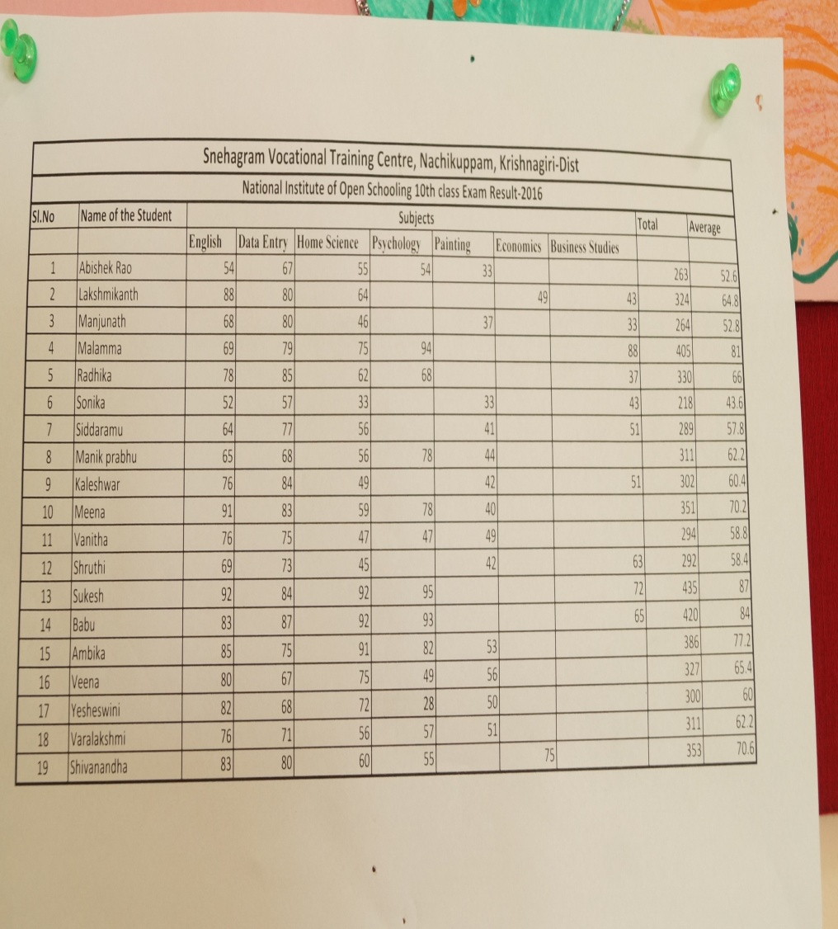
First Batch of our 18 students successfully completed our 10th exam in 2016

Slide 8
After 10th program
Many of us after 10th program have been engaging ourselves in various job oriented classes and training. And four of our friends have left to their home with a mind to find some courses and jobs to start up their lives.
Organic farming
Dairy farming
Poultry
Marketing
Reuse project
Tailoring
Personal studies

Slide 9
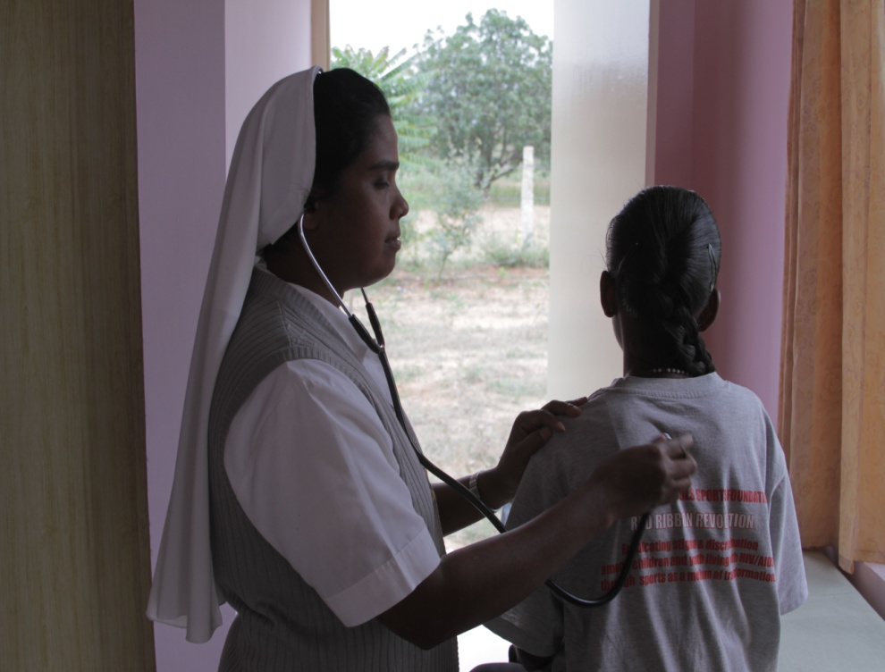
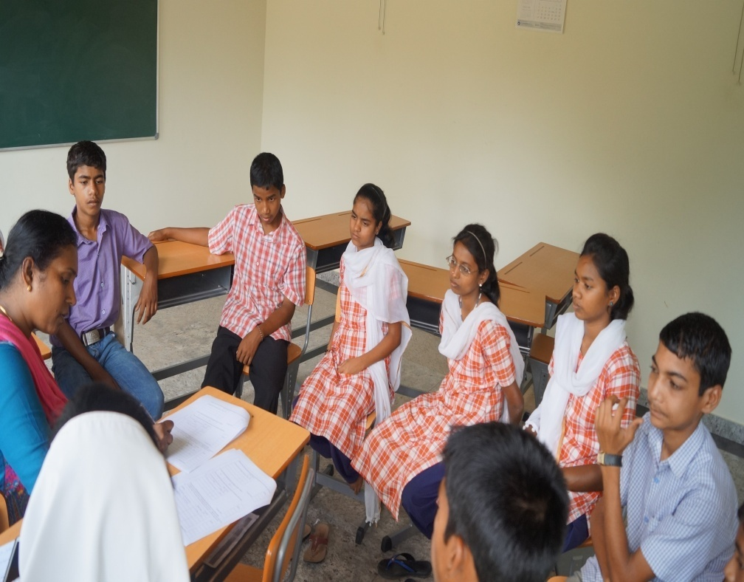
comprehensive
holistic Health care
To ensure quality of life through comprehensive and holistic health care integrated with adequate psycho-social and emotional well being.

Slide 10
Our approach
1.Preventive: In this model of approach we take all the measures to prevent certain illnesses like cough, cold and other diseases that we are prone to get
.
2.Promotive:In this model approach we practice many health promoting practices such as balanced diet, yoga and exercise, sports and etc.
3.Curative: In this model of approach we receive on going medication such as ART Anti retroviral treatment, physiotherapy,

Slide 11
Psycho- social wellbeing.
1.Peer interaction
2.Interaction with volunteers and various segments of people
3.Exposure visits
4.Family relatives

Slide 12
Emotional well being &Mental health
Environment
Emotional well being groups
Guidance by staff and mentors
External counseling help Sr. Bridget
Psycatric help and evaluation by
Dr.Rinku

Slide 13
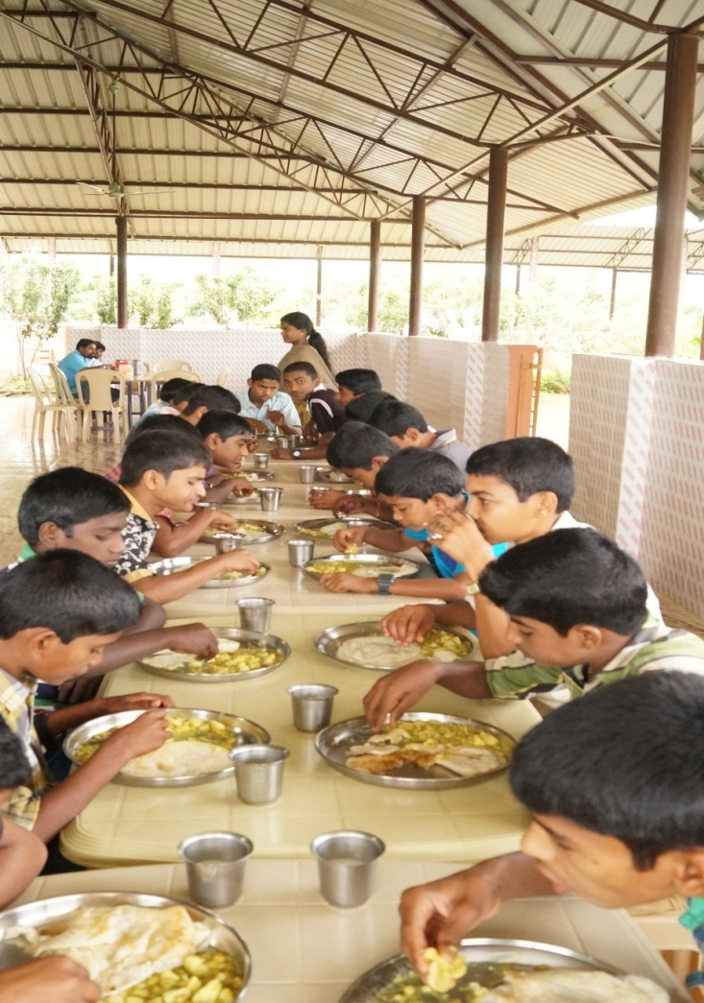
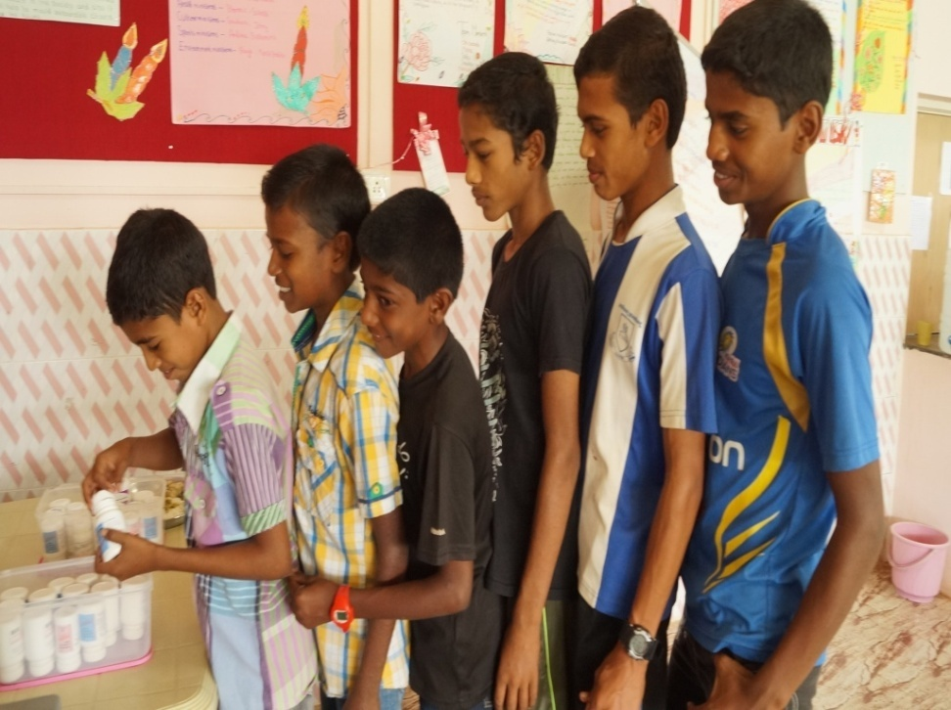
Best practices in snehagram to be healthy
Medical support ( Onsite and Referral systems)
Nutritional care

Slide 14
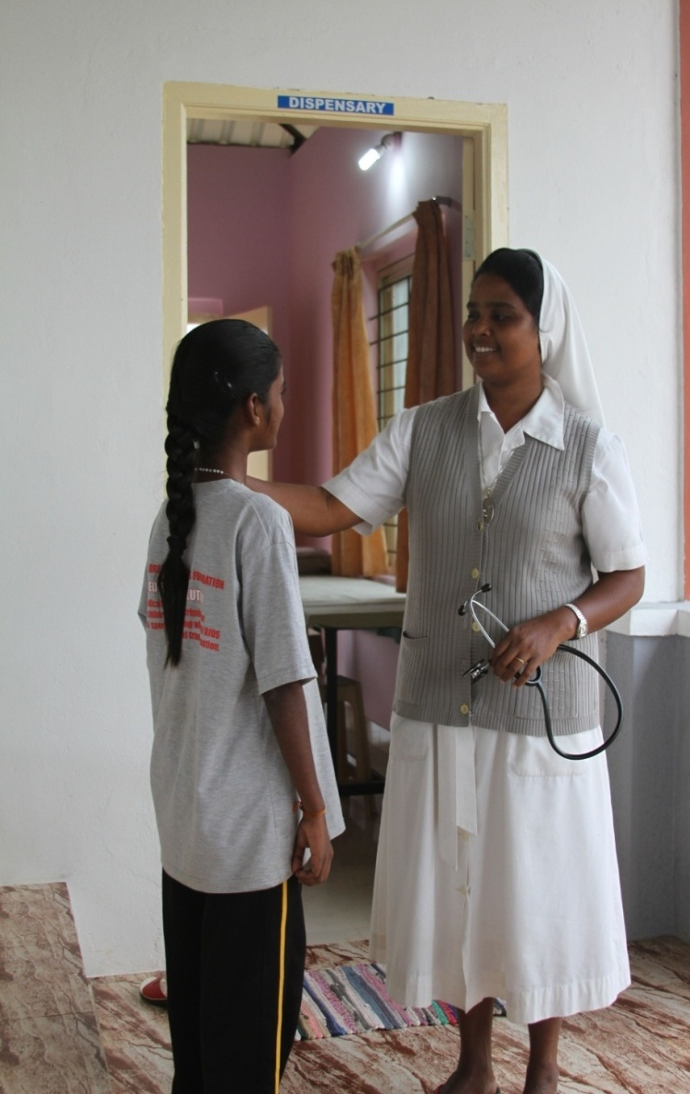
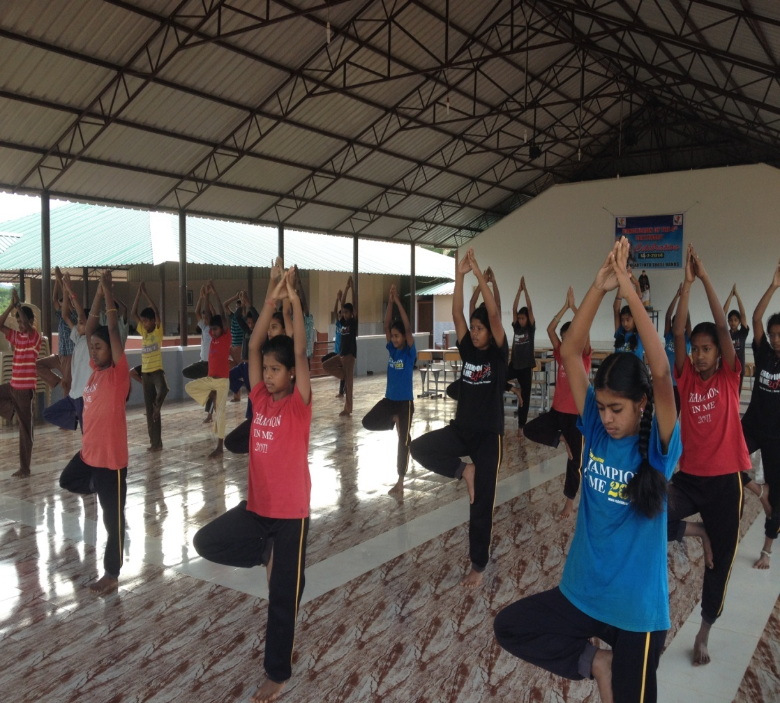
Emotional support systems
Yoga and Breathing Exercises

Slide 15
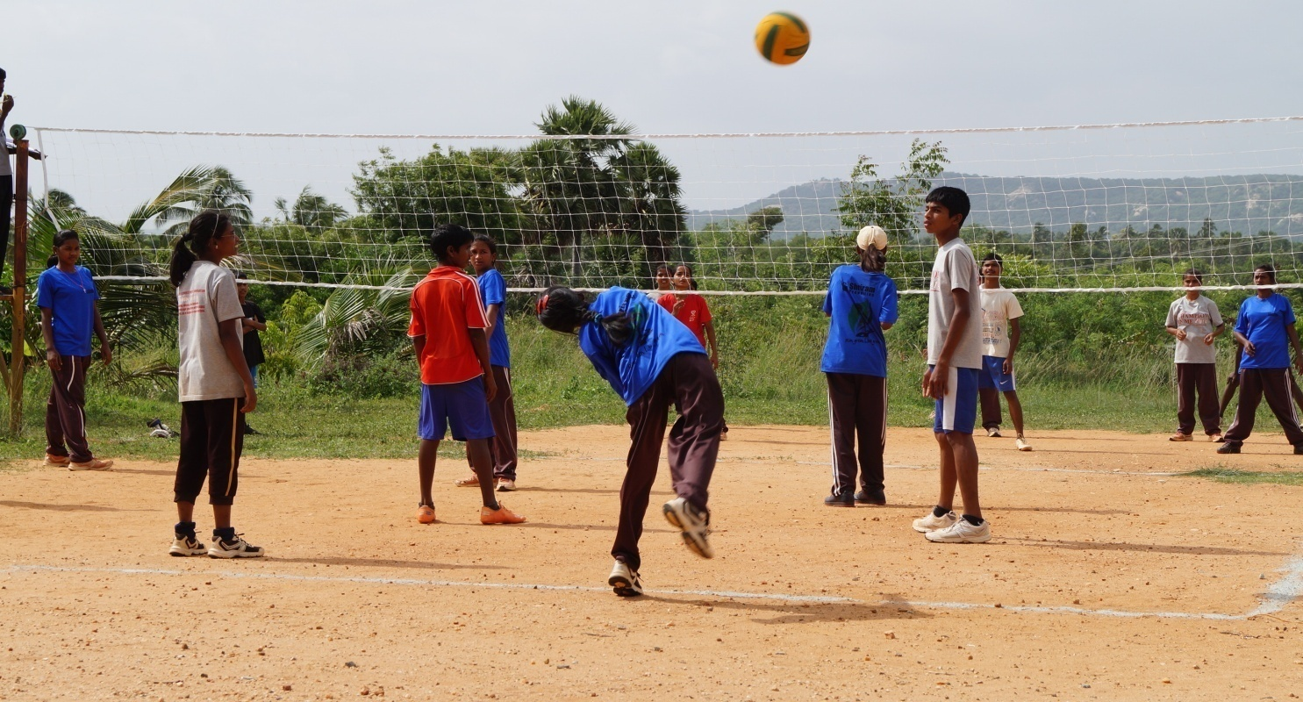
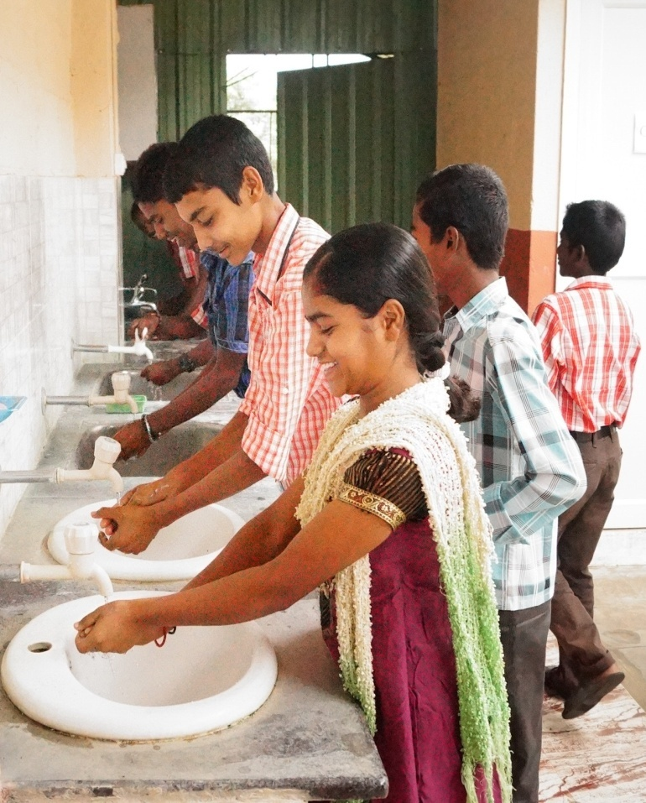
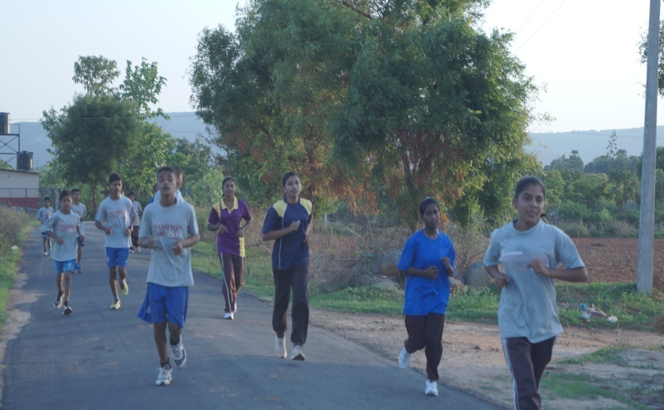
Hygiene
Running and Sports

Slide 16
4. Build self esteem and confident through life skill training guidance and support.
Camps
Workshops
Facilitating the young ones

Slide 17
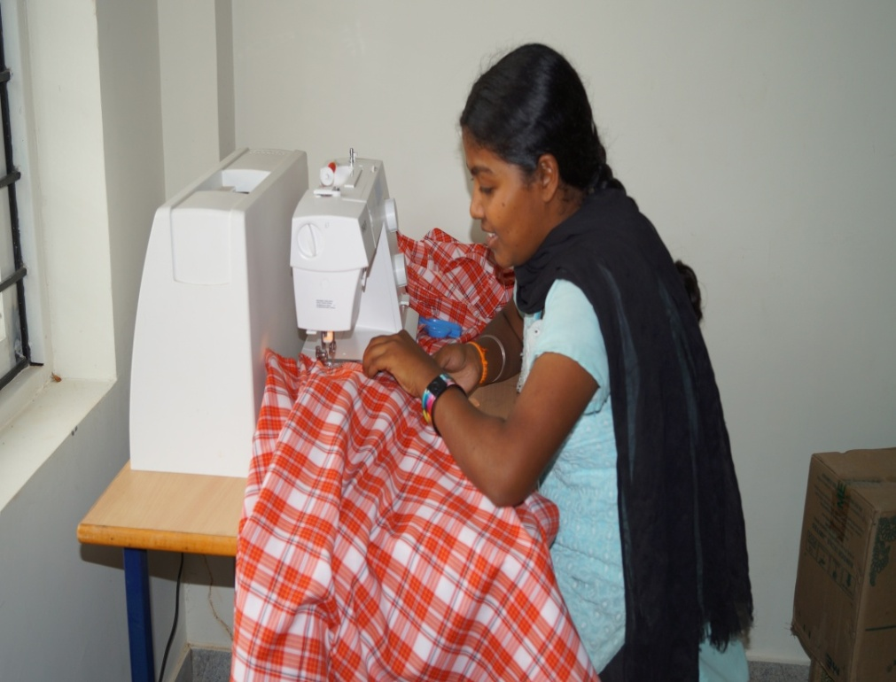
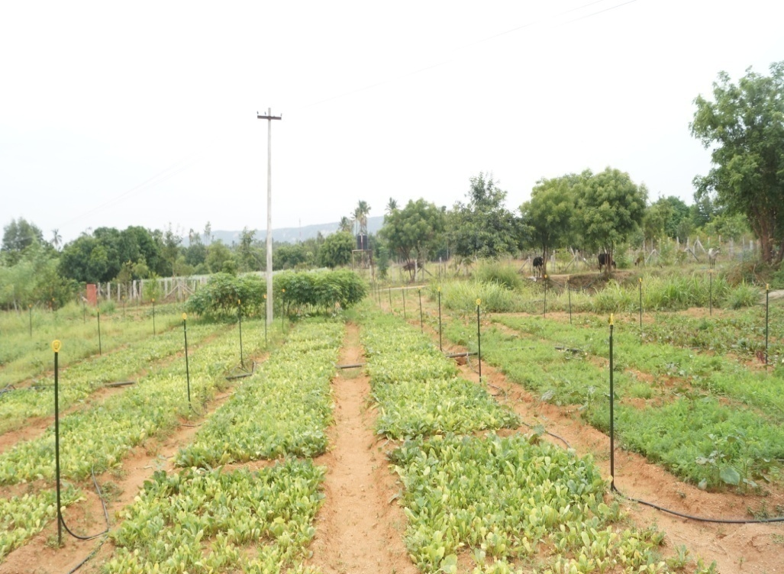
Vocational Training
5. To develop skills for securing job through vocational training based on aptitude.
FARMING
TAILORING

Slide 18
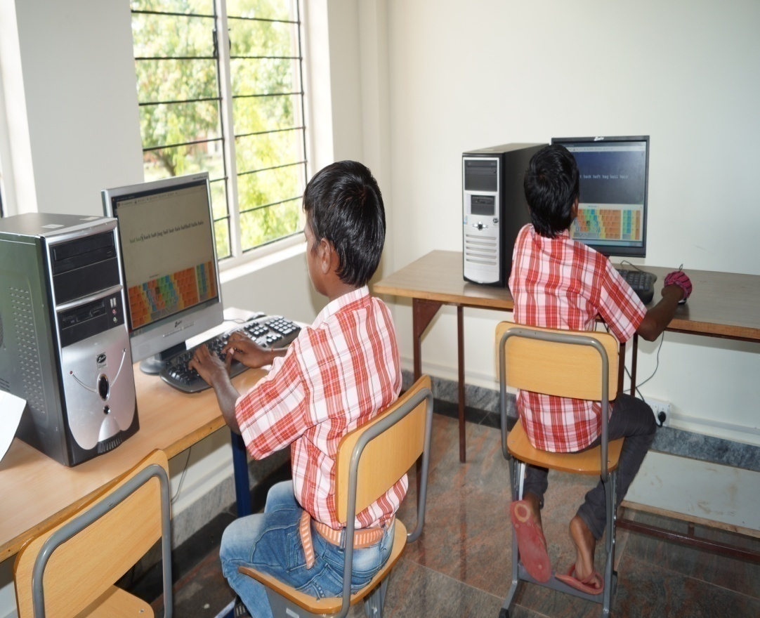
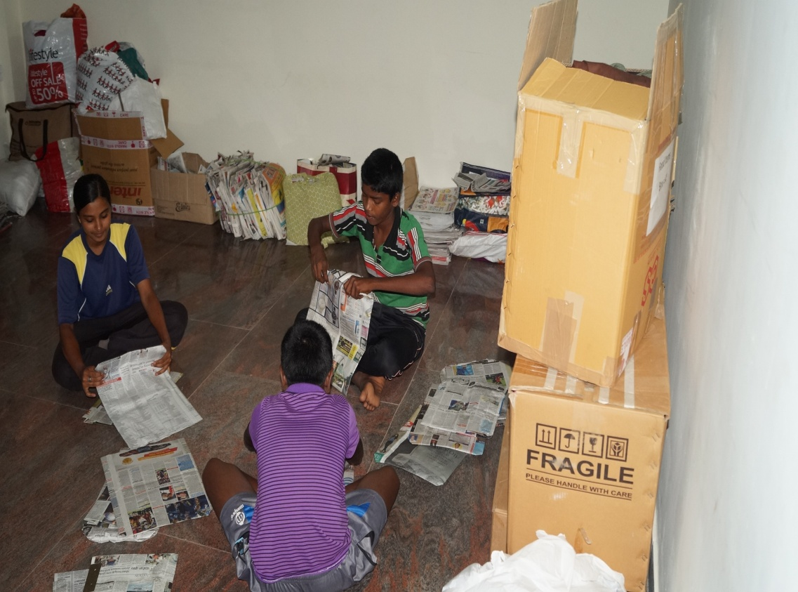
COMPUTER
RECYCLING

Slide 19
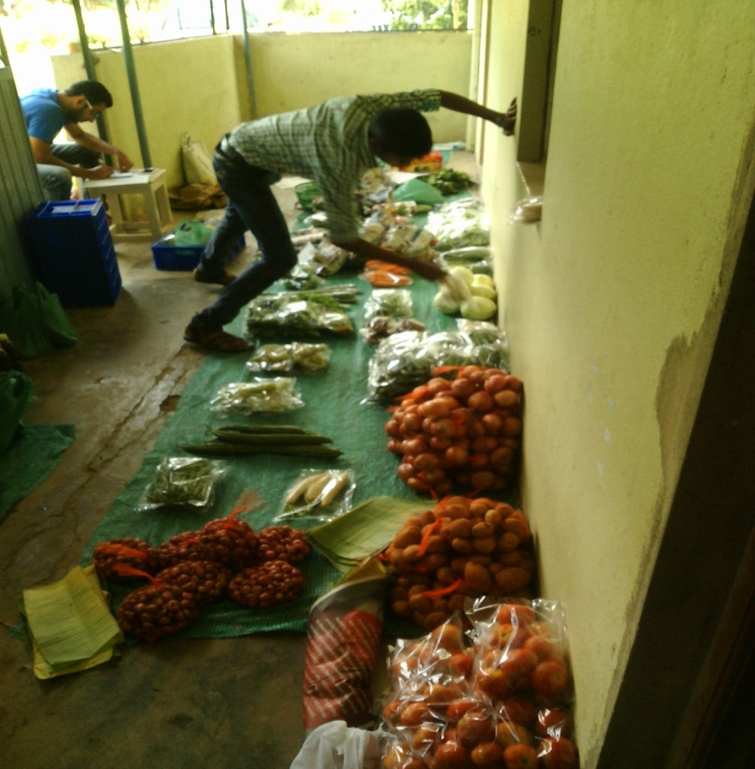
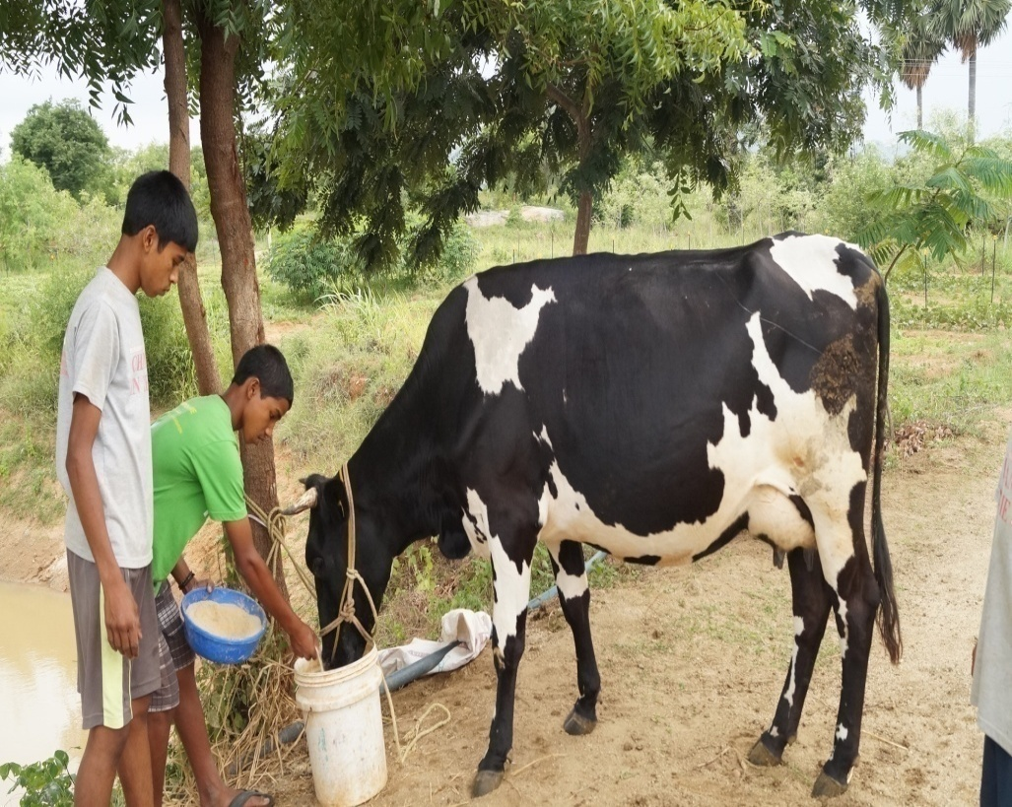
MARKETING
DAIRY FARMING

Slide 20
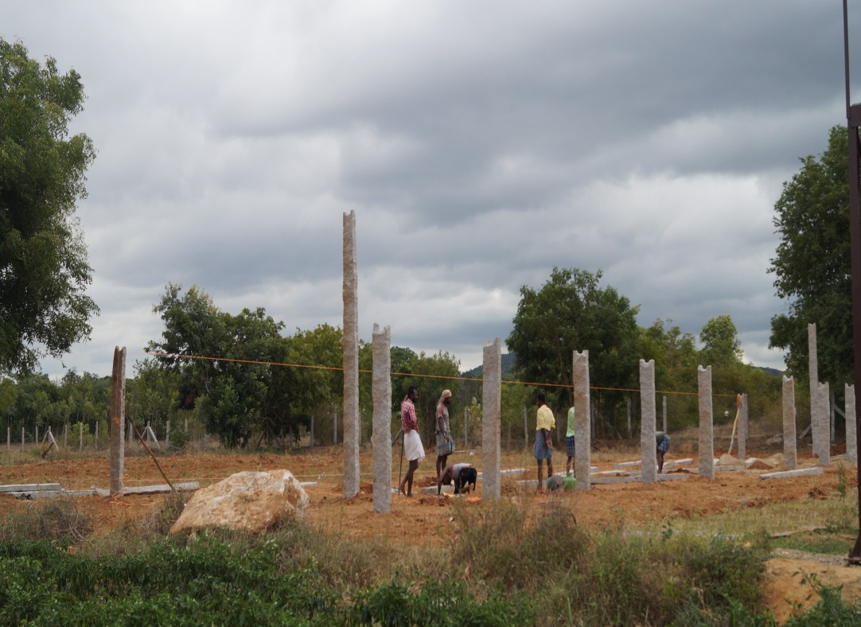
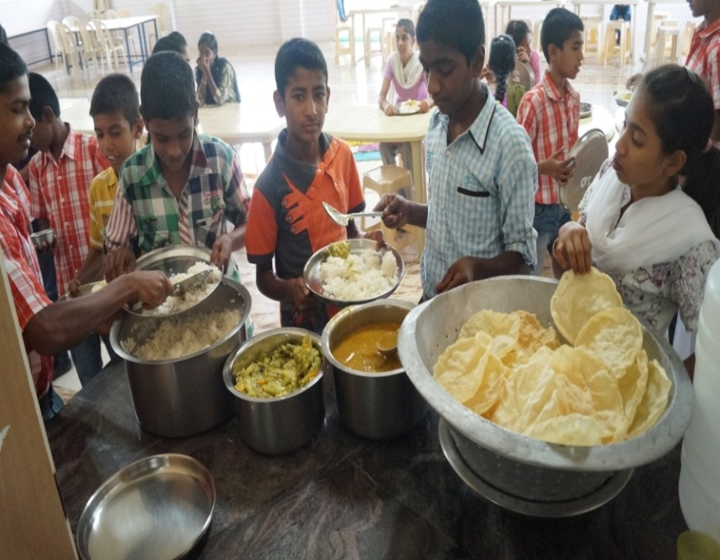
CATERING
POULTRY

Slide 21
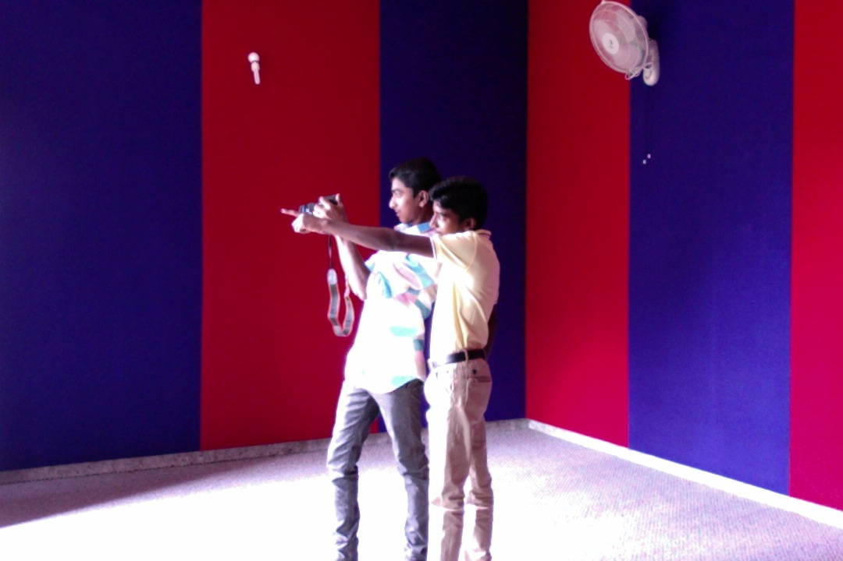
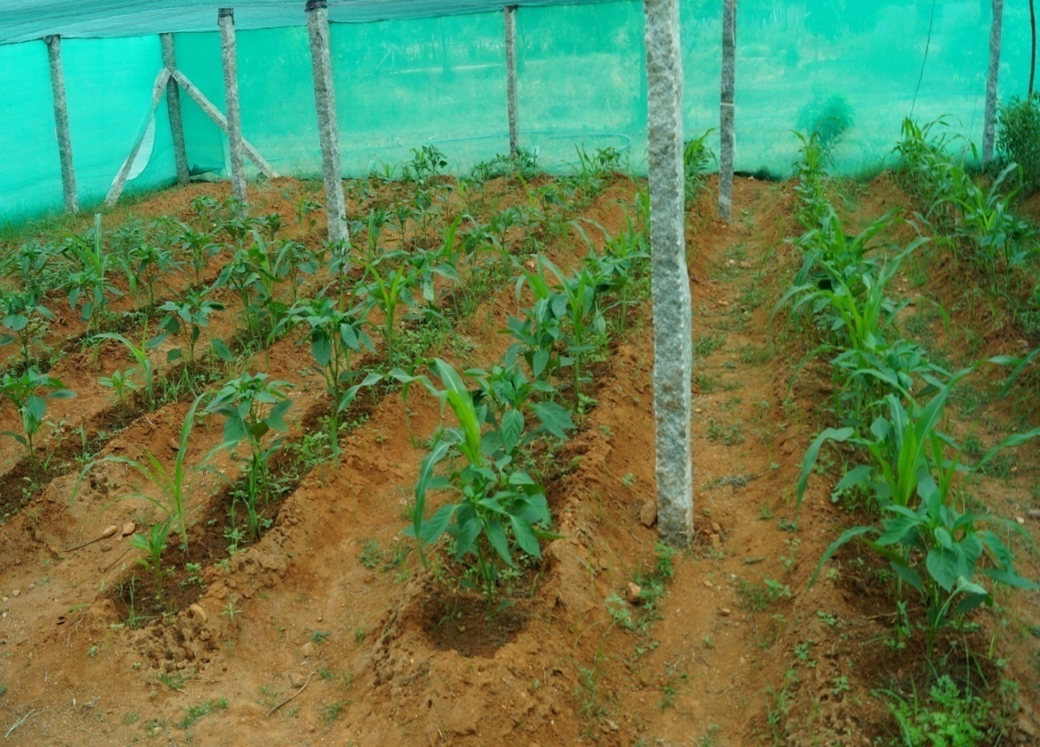
PHOTOGRAPHY
NURSERY

Slide 22
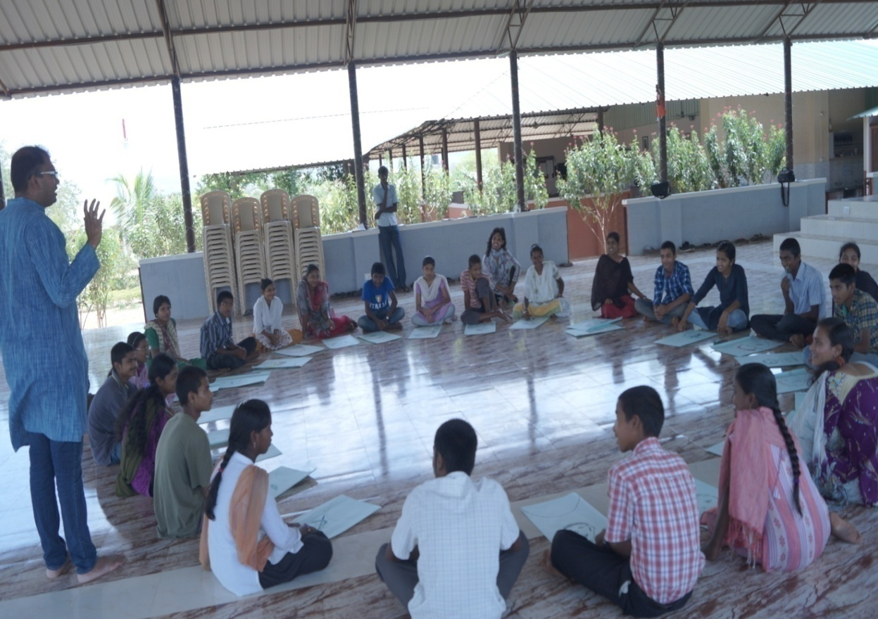
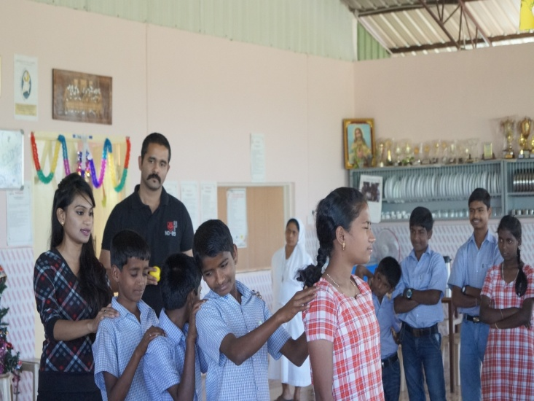
WORKSHOPS
To guide and support the students to transition into responsible, healthy and hope filled adults
Leadership
Communication
Personality development
Life skill
Entrepreneurship training
Career guidance

Slide 23
Out reach program
1.Children of krishnagiri project (Kalangare camp)
2.Children of community
3. Community outreach

Slide 24
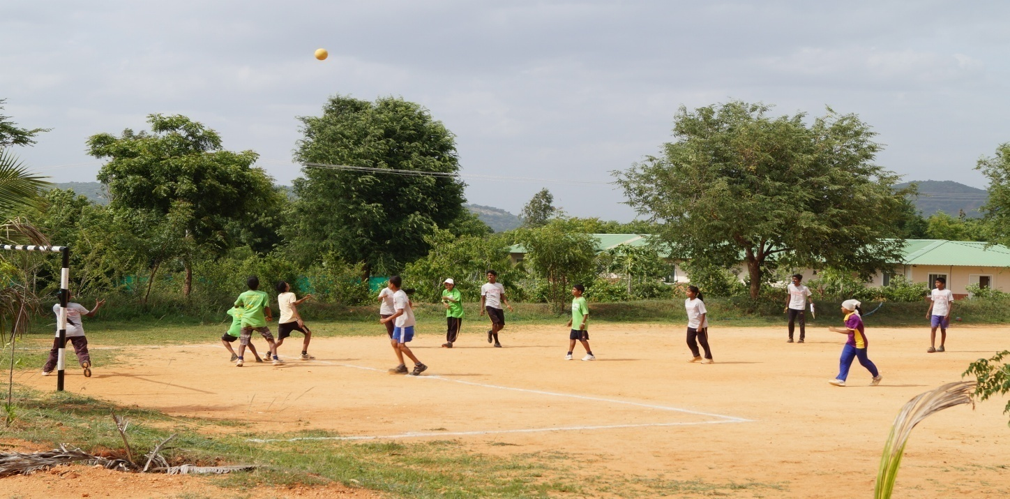
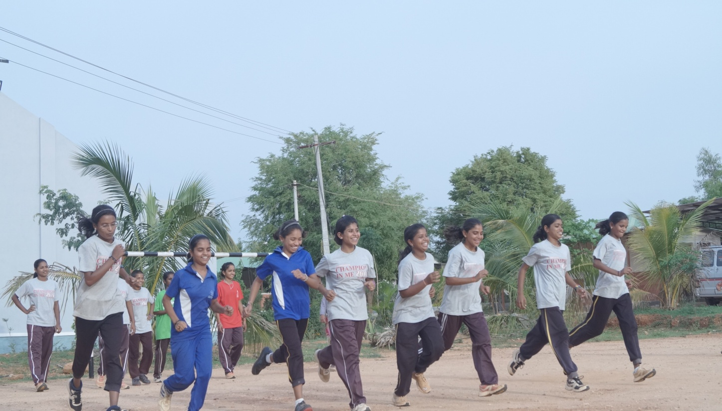
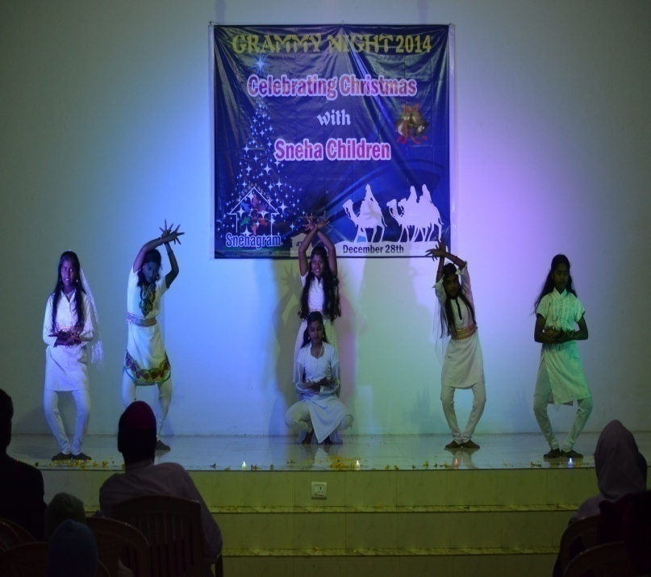
Co-curricular activities
Sports
Dance
Gardening
Yoga
Exercise
Running
Exposure visits
Creativity development
Cultural programs

Slide 25
Festivals
We celebrate all national days and also many religious festivals such as :
Republic day
Independence day
Gandhi jayanthi
Pongal
Ugadi
Diwali
Onam
Christmas
Holi

Slide 26
Partnership &Collaboration
Camillians
Daughters Of Divine Providence
Karnataka Health Promotion Trust
St. John’s Medical College Hospital
Boston University
Runners High, Bangalore
International Service Agency (INSA-India)
Christ University
ICRDCE ,Chennai
Bangalore School Sports Foundation (BSSF)
Learn For Life Foundation, USA

Slide 27
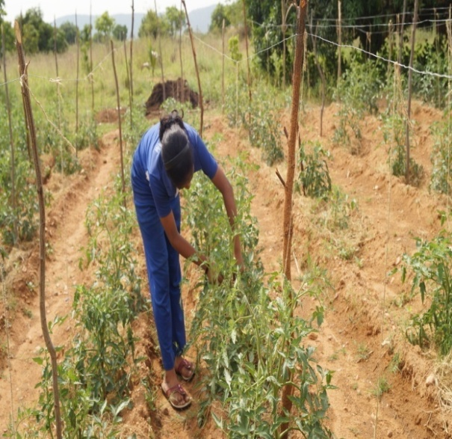
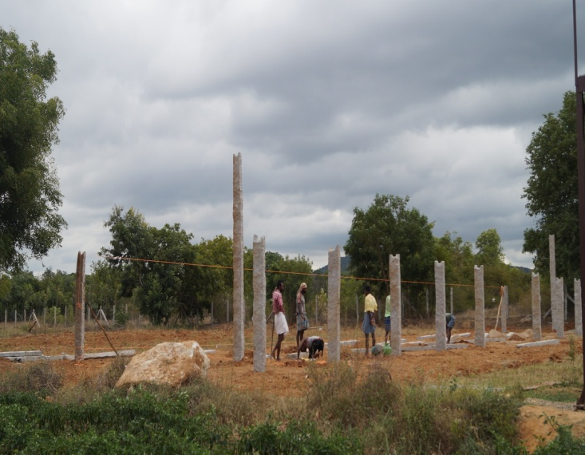
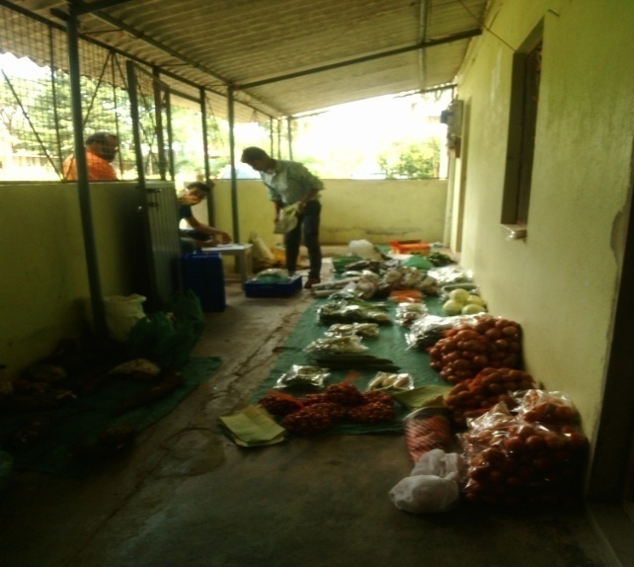
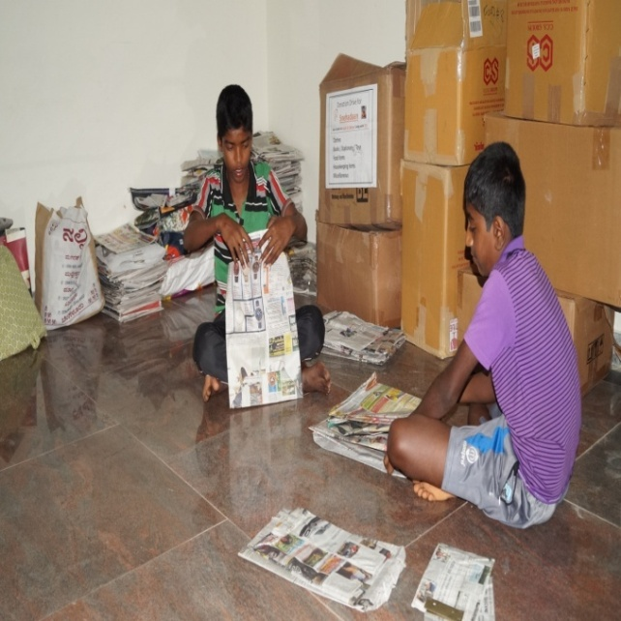
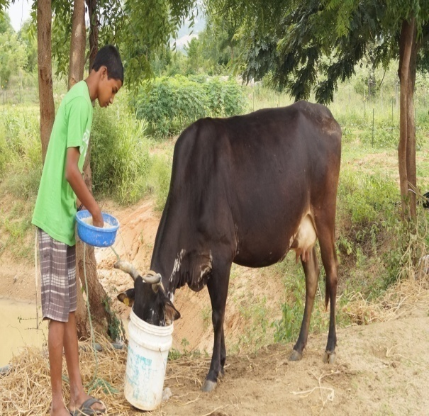
Sustainability projects
Farming
Poultry
Farming
Marketing
Dairy farm
Recycling

Slide 28
Thank you

